Slide 1
Living Faith

Slide 2
What does it look like to live by faith in God’s Word?

Slide 3
You will live in light of the Judgment Seat of Christ!

Slide 4
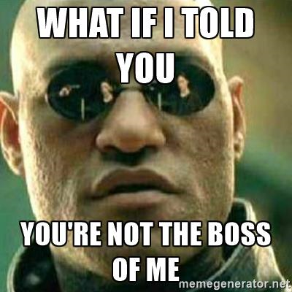
BY FAITH
SUBMISSION TO BIBLICAL AUTHORITY IS SAFE FOR US. Vs 17a
We rebel against 2 primary reasons.
  FEAR. Num 14
  PRIDE. Isa 14
  Result: Rebellion.

Slide 5
Romans 14:4 Who art thou that judgest another man's servant? to his own master he standeth or falleth. Yea, he shall be holden up: for God is able to make him stand.

Slide 6
The Solution?
Repent.
Submit.

Slide 7
1 Corinthians 16:15-16 I beseech you, brethren, (ye know the house of Stephanas, that it is the firstfruits of Achaia, and that they have addicted themselves to the ministry of the saints,) 16 That ye submit yourselves unto such, and to every one that helpeth with us, and laboureth.

Slide 8
1 Peter 5:5 Likewise, ye younger, submit yourselves unto the elder. Yea, all of you be subject one to another, and be clothed with humility: for God resisteth the proud, and giveth grace to the humble.

Slide 9
BY FAITH
THOSE IN BIBLICAL AUTHORITY ARE ALSO ACCOUNTABLE BEFORE GOD. Vs 17b
Pastors are to speak and live out the word of God – not their opinions or preferences.
Growing leaders: Exercise authority only at the point you are under authority!

Slide 10
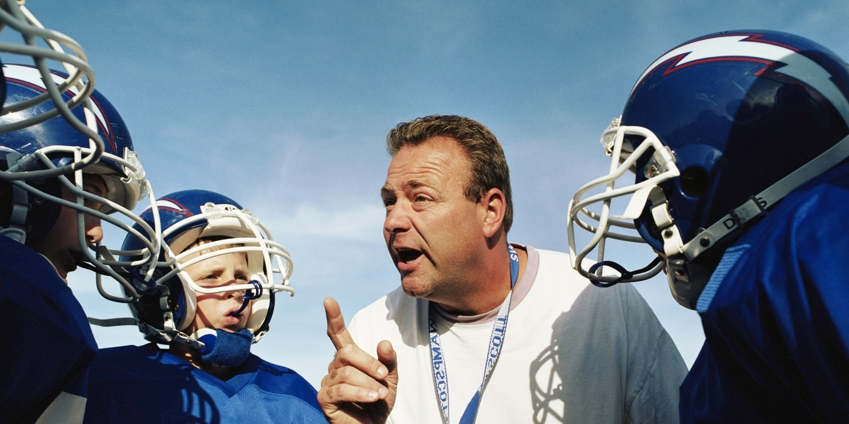
BY FAITH
SUBMISSION TO BIBLICAL AUTHORITY IS PROFITABLE FOR US. Vs 17b

Slide 11
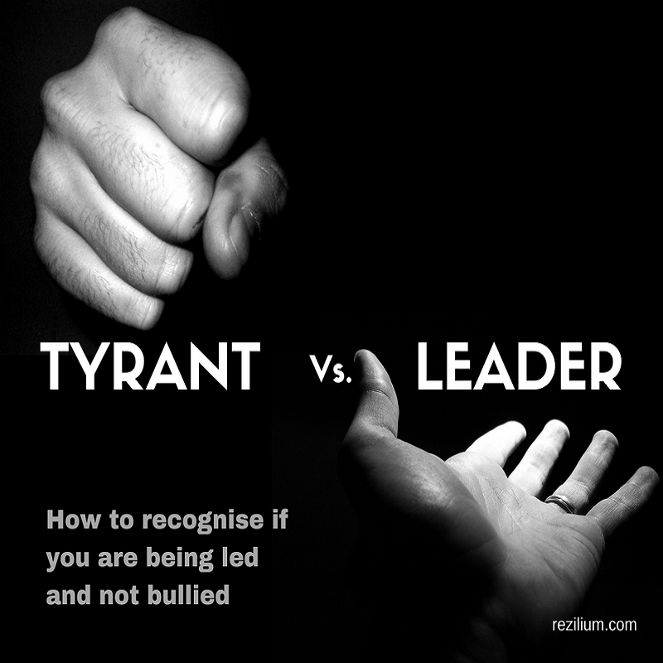


Slide 12
1 Peter 5:3 Neither as being lords over God's heritage, but being ensamples to the flock.

Slide 13
John 10:11-14 I am the good shepherd: the good shepherd giveth his life for the sheep. 12 But he that is an hireling, and not the shepherd, whose own the sheep are not, seeth the wolf coming, and leaveth the sheep, and fleeth: and the wolf catcheth them, and scattereth the sheep. 13 The hireling fleeth, because he is an hireling, and careth not for the sheep. 14 I am the good shepherd, and know my sheep, and am known of mine.

Slide 14
Disciplers!
Most workers in the church want to win souls, they don’t want to watch for souls!

Slide 15
You pursue maturity in Christ.

Slide 16
Living Faith

